Slide 1
I. Database Management System
Data resources must be structured and organized in some logical manner so they can be accessed, processed, retrieved, and managed easily

Slide 2
II. Fundamental Data Concepts
Character – the most basic logical data element that can be observed, a single alpha or numeric or other symbol, represented by one byte
Field – a grouping of related characters, as a last name or a salary, represents an attribute of some entity General Purpose Application Programs – perform common information processing jobs for end users

Slide 3
II. Fundamental Data Concepts
Record – a grouping of attributes that describe an entity
File – a group of related data records
Database – a collection of logically related data elements

Slide 4
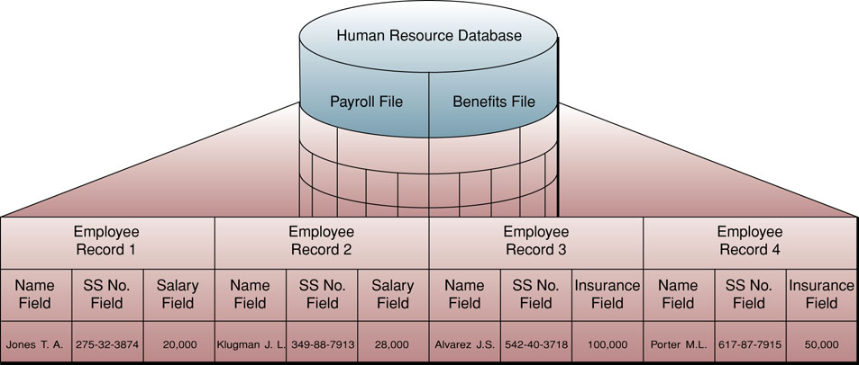
II. Fundamental Data Concepts

Slide 5
III. Database Structures (Models)
Hierarchical Structure – treelike structure of one-to-many parent-child relationships (each child can have only one parent)
Network Structure – similar to hierarchical but allows many-to-many relationships (a child record can have more than one parent)
Relational Structure – the most widely used database model today; data is represented as a series of two-dimensional tables called Relations; each column is a named attribute of the entity, each row is an unnamed instance of that entity

Slide 6
III. Database Structures (Models)
Relational Operations
  Select – create a subset that meets a criterion
  Join – temporarily combine two or more tables for comparison
  Project – create a subset of the columns in the temporary tables
Multidimensional Structure – variation of the Relational model using multidimensional structures to organize and express relationships

Slide 7
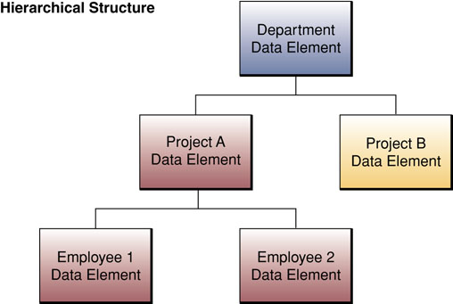
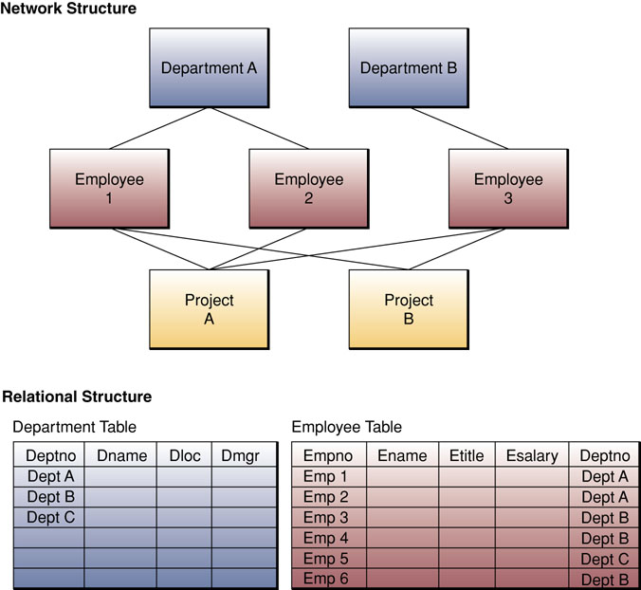
III. Database Structures (Models)

Slide 8
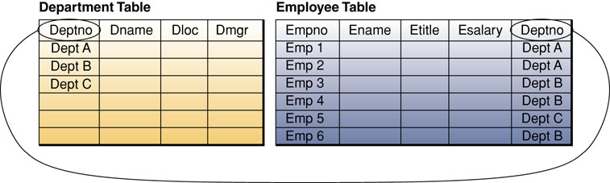
III. Database Structures (Models)

Slide 9
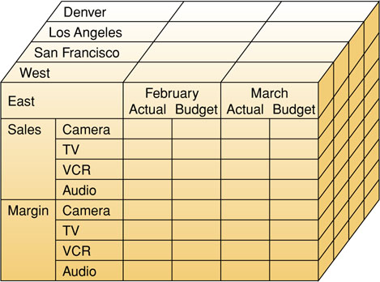
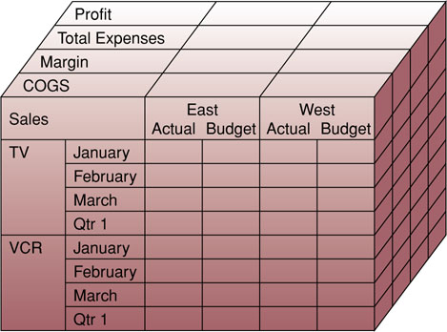
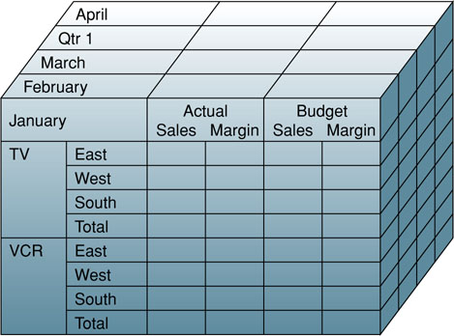
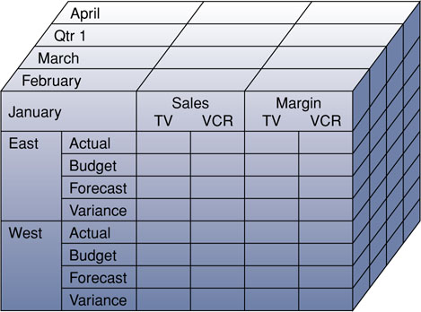
III. Database Structures (Models)

Slide 10
III. Database Structures (Models)
Object-Oriented Structure – combining the data of interest and the processes that act on that data into a structure called an object
  Encapsulation – allows complex data types
  Inheritance – allows replication of some/all of the characteristics of a parent object in the creation of a child object
Evaluation of Database Structures – databases have grown more complex as needs have changed and grown in complexity

Slide 11
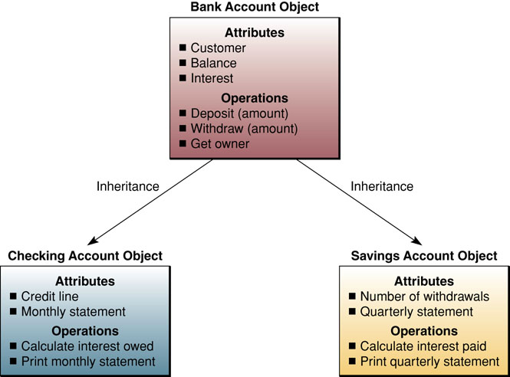
III. Database Structures (Models)

Slide 12
Database Pioneer Rethinks the Best Way to Organize Data
How do databases currently focus on data to be stored?
What is suggested as a better away to focus on data warehouses?
What gains do these changes promise?

Slide 13
IV. Database Development
Database Administrator (DBA) – controls development and administration of the database
Data Definition Language (DDL) – used to specify the contents, relationships, and structure of the database
Data Dictionary – directory containing the metadata

Slide 14
IV. Database Development
Metadata – data about the data
Data Planning and Database Design
  Data Modeling (Entity-Relationship Diagrams) – logical models of the data itself; this must be done before choosing the database model
  Schema – the physical/internal view of a system
  Subschema – the logical/external view of a system

Slide 15
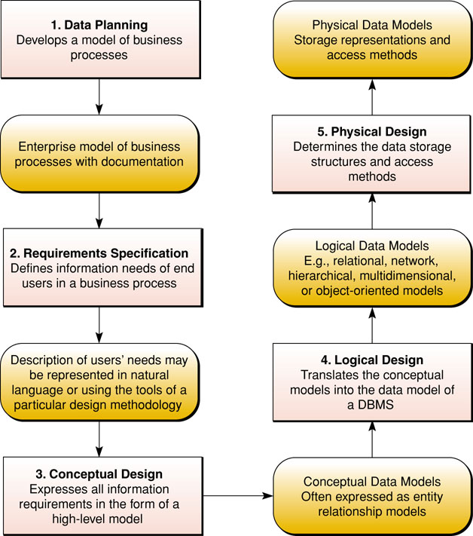
IV. Database Development

Slide 16
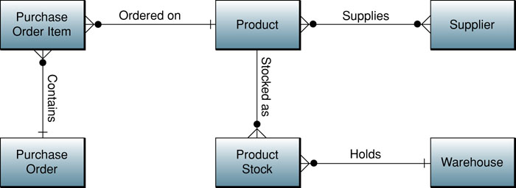
IV. Database Development
Entity Relationship Diagram

Slide 17
I. Data Resource Management
Data are an organizational resource that must be managed as any other resource

Slide 18
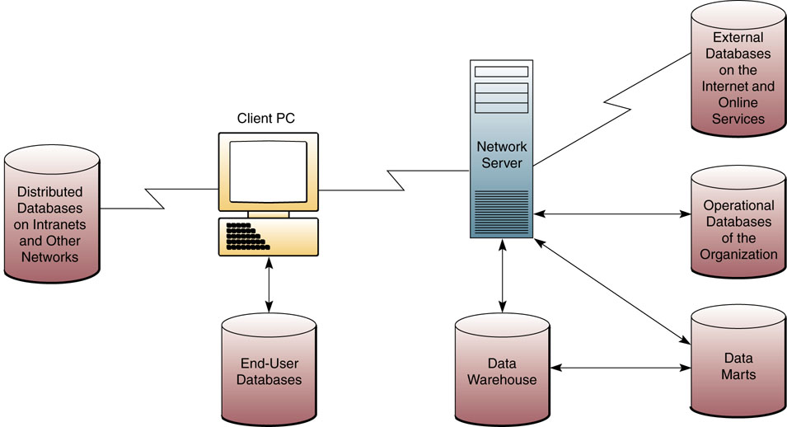
I. Data Resource Management
Types of Databases Used by Organizations and End-Users

Slide 19
II. Types of Databases
Operational Databases – store detailed data to support business processes and operations
Distributed Databases – many organizations distribute their databases over multiple locations
  Replication – complex process of updating distributed data
  Duplication – simplified method of updating distributed data

Slide 20
II. Types of Databases
External Databases – outside the firm, free or fee-based
Hypermedia Databases – hyperlinked pages of multimedia

Slide 21
III. Data Warehouses and Data Mining
Data Warehouse – stores data extracted from other databases
Data Mart – subset of a data warehouse focusing on a single topic, customer, product, etc.
Data Mining – analyzing a data warehouse to reveal hidden patterns and trends

Slide 22
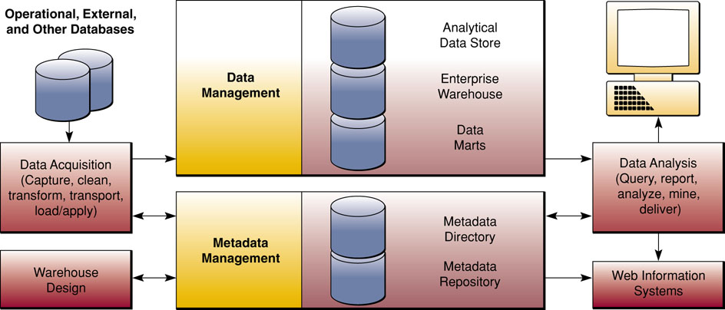
III. Data Warehouses and Data Mining
Components of a Data Warehouse System

Slide 23
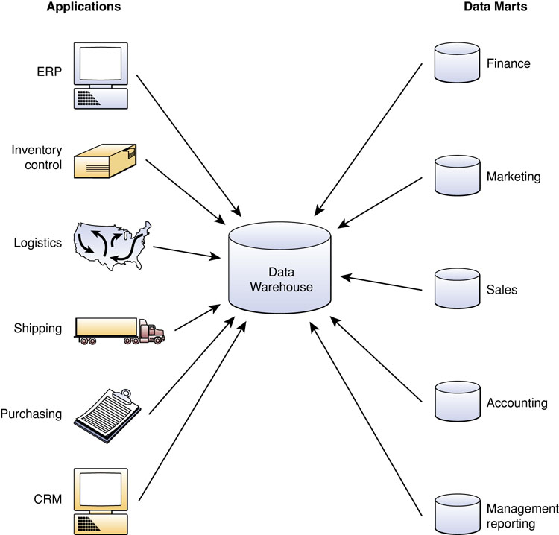
III. Data Warehouses and Data Mining
A Data Warehouse and its Data Mart Subsets

Slide 24
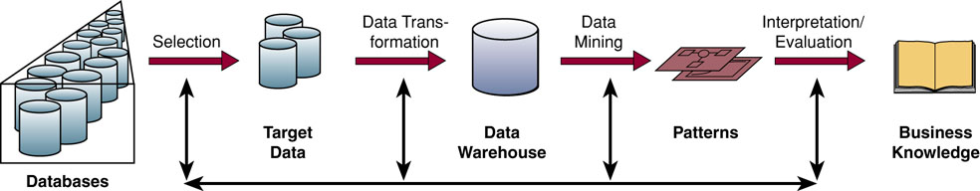
III. Data Warehouses and Data Mining
Data Mining Extracts Business Knowledge from a Data Warehouse

Slide 25
IV. Traditional File Processing
Data was stored in independent files without regard to other needs for that data
Problems of File Processing – databases seek to solve these problems
  1. Data Redundancy – the same data is kept in more than one location; databases seek to Control (NOT reduce!) Redundancy; this led to Data Inconsistency – same data in multiple locations but the Values were Different

Slide 26
IV. Traditional File Processing
Problems of File Processing – databases seek to solve these problems
  2. Lack of data Integration – data not easily available for ad hoc requests
  3. Data Dependence – data and programs were “tightly coupled”, changing one meant having to change the other
  4. Lack of Data Integrity (Standardization) – data was defined differently by different end users or applications

Slide 27
V. Database Management Approach
Consolidate the data from separate files into databases accessible by multiple application programs
  Database Management System (DBMS) – a collection of programs to create, maintain, and use (retrieve) data in a database
  Database Maintenance – organizational databases need to be updated continually
  Application Development – facilitated by the Data Manipulation Language (DML) provided by the DBMS

Slide 28
V. Database Management Approach
Database Interrogation – query (“ask”) the database for information
  Query Language – allows ad hoc requests of the
  database
  SQL Queries (Structured Query Language) –
  standard query language found in many
  databases
  Boolean Logic – 3 logical operators: AND, OR,
  and NOT
  Graphical and Natural Queries – easier methods
  of structuring SQL statements

